Slide 1

Stabilizare video

Slide 2
Pasul 1
Video Frames Load
&
RGB to Grayscale
Pasul 2
Feature Tracking intre 2 frame-uri consecutive
Pasul 3
Calcul
transformate
Pasul 6
Video Write
Pasul 5
Video Crop
Pasul 4
Aplicare
transformate

Slide 3
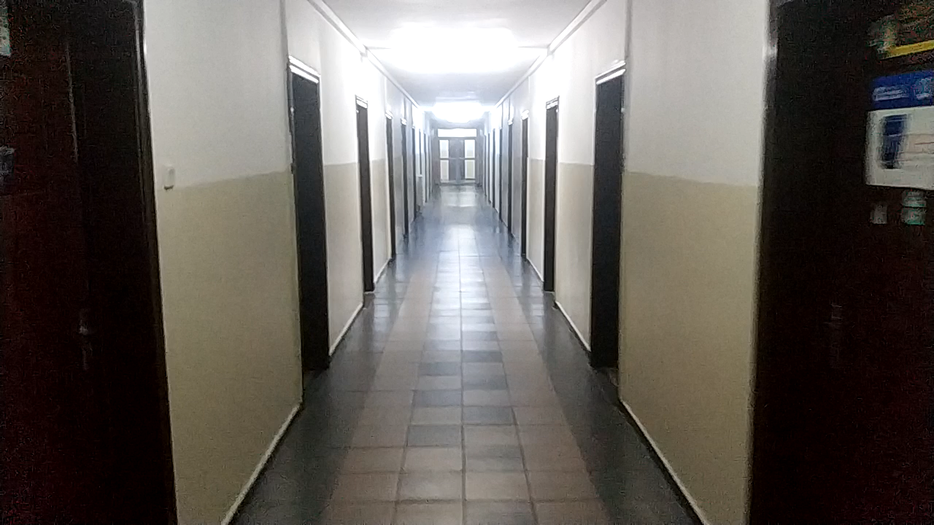
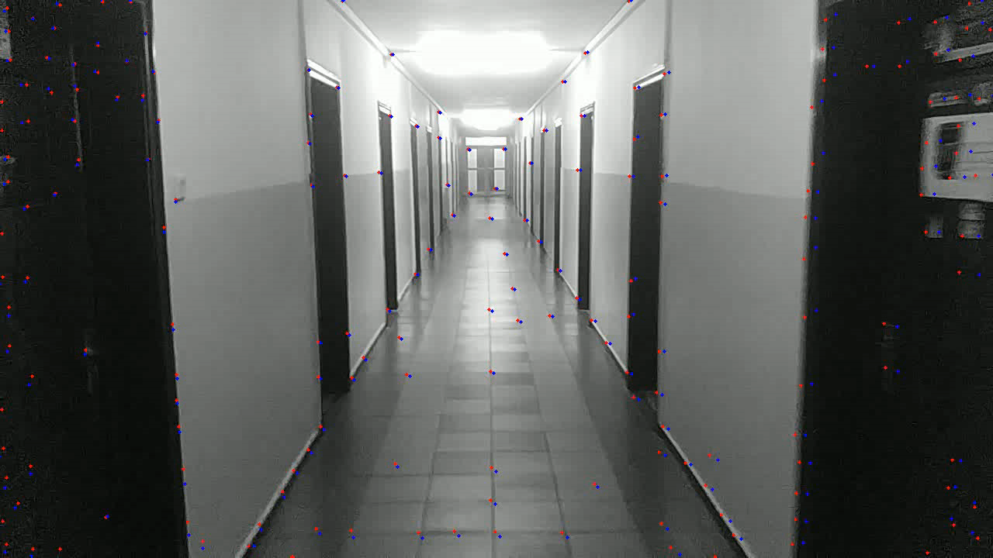
Pasul 2
Feature Tracking inte 2 frame-uri consecutive
OpenCV
goodFeaturesToTrack
&
calcOpticalFlowPyrLK

Slide 4
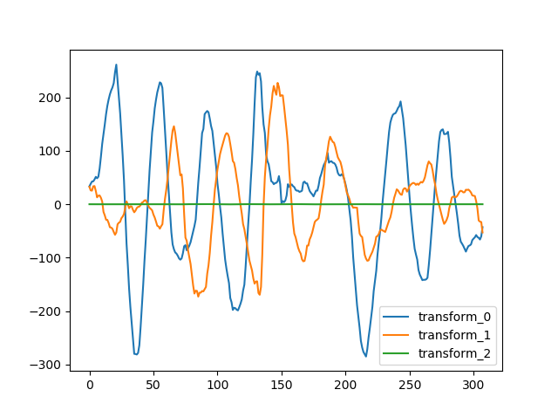
Pasul 3
Calcul
transformate
OpenCV
estimateAffinePartial2D

Slide 5
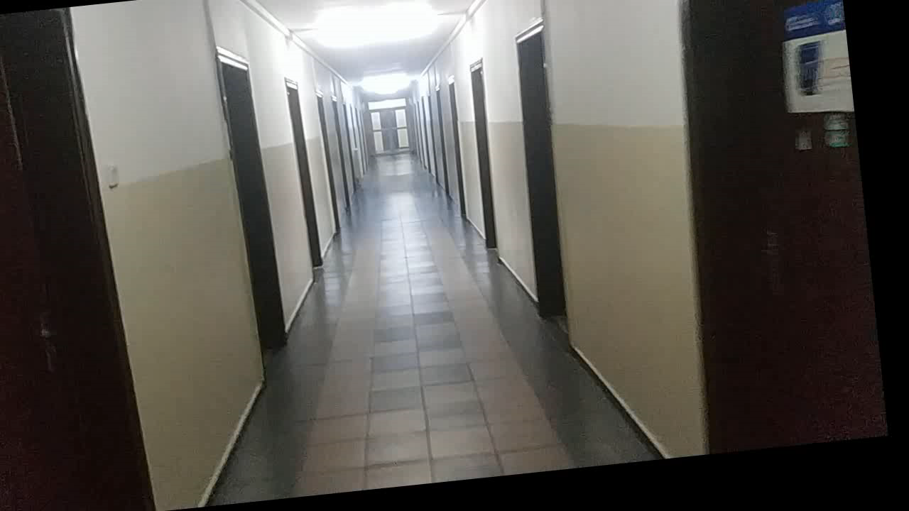
Pasul 4
Aplicare
transformate
OpenCV
warpAffine

Slide 6
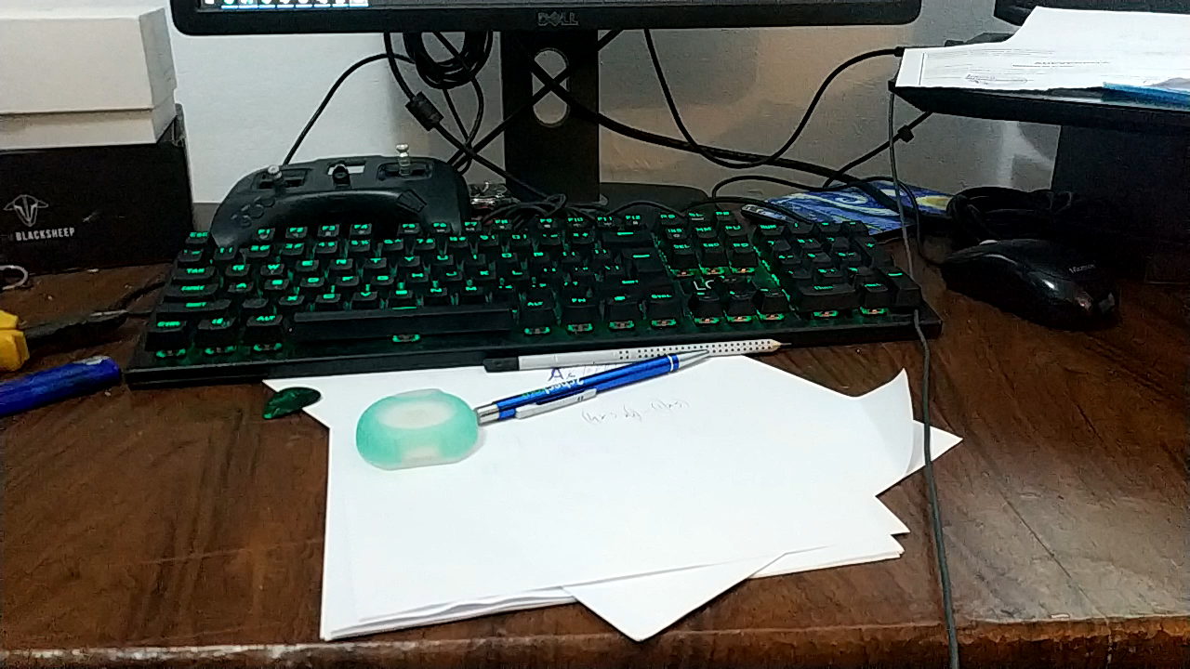
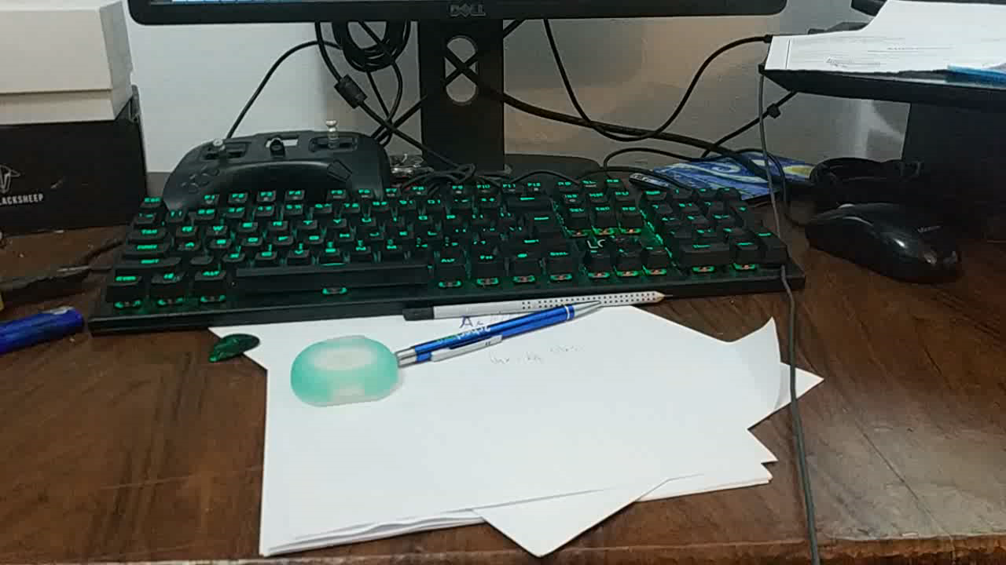
Pasul 4
Aplicare
transformate
OpenCV
warpAffine

